Slide 1

“Just That They’d Followed The Directions”: Teachers, Wiki Quality, and Wiki Assessment
Justin Reich
M. Shane Tutwiler
Richard Murnane
John Willett
The State of Wiki Usage in U.S. K-12 Schools
Justin Reich
Richard Murnane
John Willett

Slide 2
Distributed Collaborative Learning Communities Project:
Web 2.0 in K-12 Settings
Excellence: How do we make them good?
Equity: Do only certain kids get the good ones?
Analytics: What can we learn about learning from real-time usage data from online learning environments

Slide 3
Agenda
Motivate the study of wikis
Map out a broad research agenda for studying wiki usage at scale
Delve into two specific studies
  Describe findings about how teachers assess quality in wiki learning environments
  Characterize the state of wiki usage in US, K-12 settings

Slide 4
Why Study Wikis?
Web 2.0 is Transforming Society
Widespread Adoption in K-12 Settings
  40% of teachers report using blogs or wikis in instruction (FRSS)
  20% of teachers report having students contribute to blogs or wikis (FRSS)
Democratic, student-centered architecture
New Sources of Data (A Watershed?)
  SCalable, Real-time, Individual Behavior and Learning (SCRIBL) data

Slide 5
Distributed Collaborative Learning Communities Project:
Web 2.0 in K-12 Settings
Excellence: How do we make them good?
Equity: Do only certain kids get the good ones?
Analytics: What can we learn about learning from SCalable, Real-time, Individual Behavior and Learning (SCRIBL) data maintained by Web 2.0 learning

Slide 6
What is good?
Quality as 21st Century Skill Development
Expert Thinking
Complex Communi-cation
New Media Literacy

Slide 7
Path Diagram of Wiki Research
School Level SES
Classroom Observations and Teacher Interviews to Understand Wiki Practices
Measure Wiki Quality
Develop Wiki Quality Trajectories
Assess How Wiki Quality Trajectories Differ by SES and Teacher Attitudes/Practices
Literature Review of CSCL and 21st C. Skill Scholarship
Initial Quantitative Analysis to Develop Sampling Strategy
Wiki User Surveys

Slide 8
How do teachers define wiki quality?
Why do teachers use wikis?
How do teachers assess quality in wiki learning environments?

Slide 9
Survey:
Why do teachers use wikis?
What do you anticipate will be the benefits for students from using a wiki?
  193 participants in a 2010 online wiki summer camp (out of ~1250)
How do you plan to use your wiki?
  667 wiki creators in summer 2010 (response rate <10%)

Slide 10
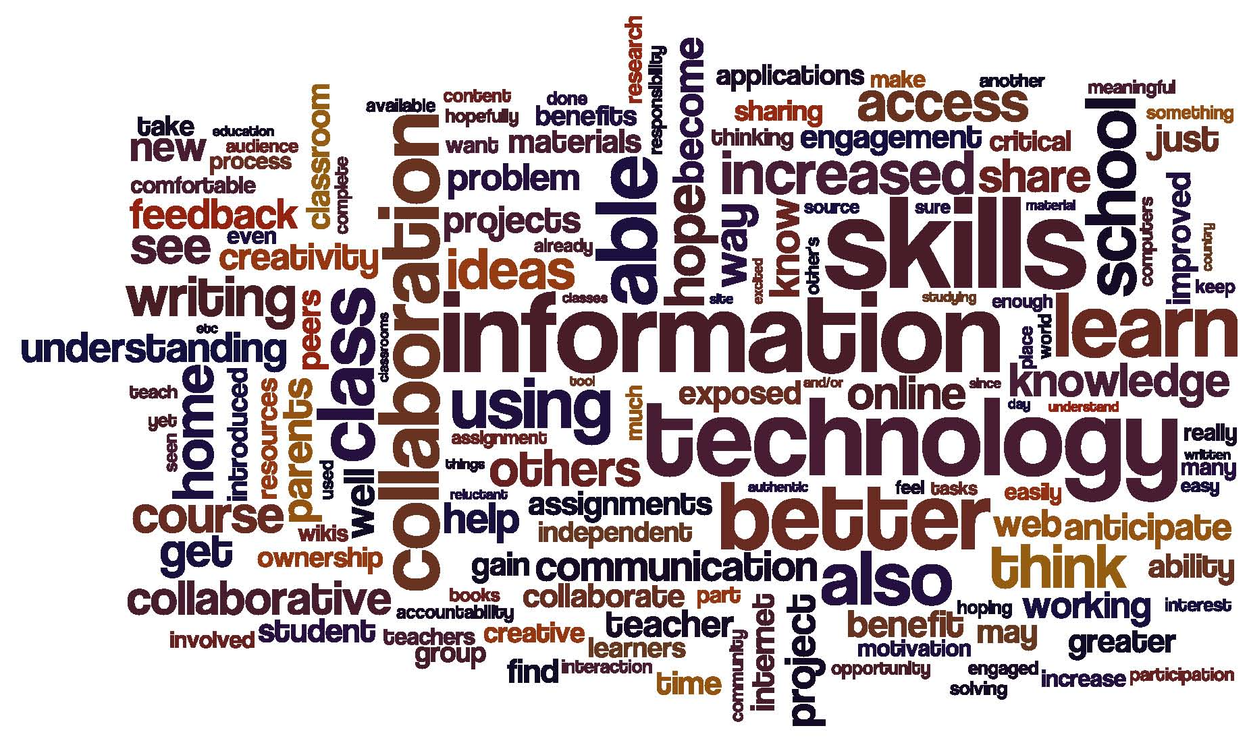
What do you anticipate will be the benefits for students from using a wiki? (n=193)
Omitted words: work, learning, wiki, student

Slide 11
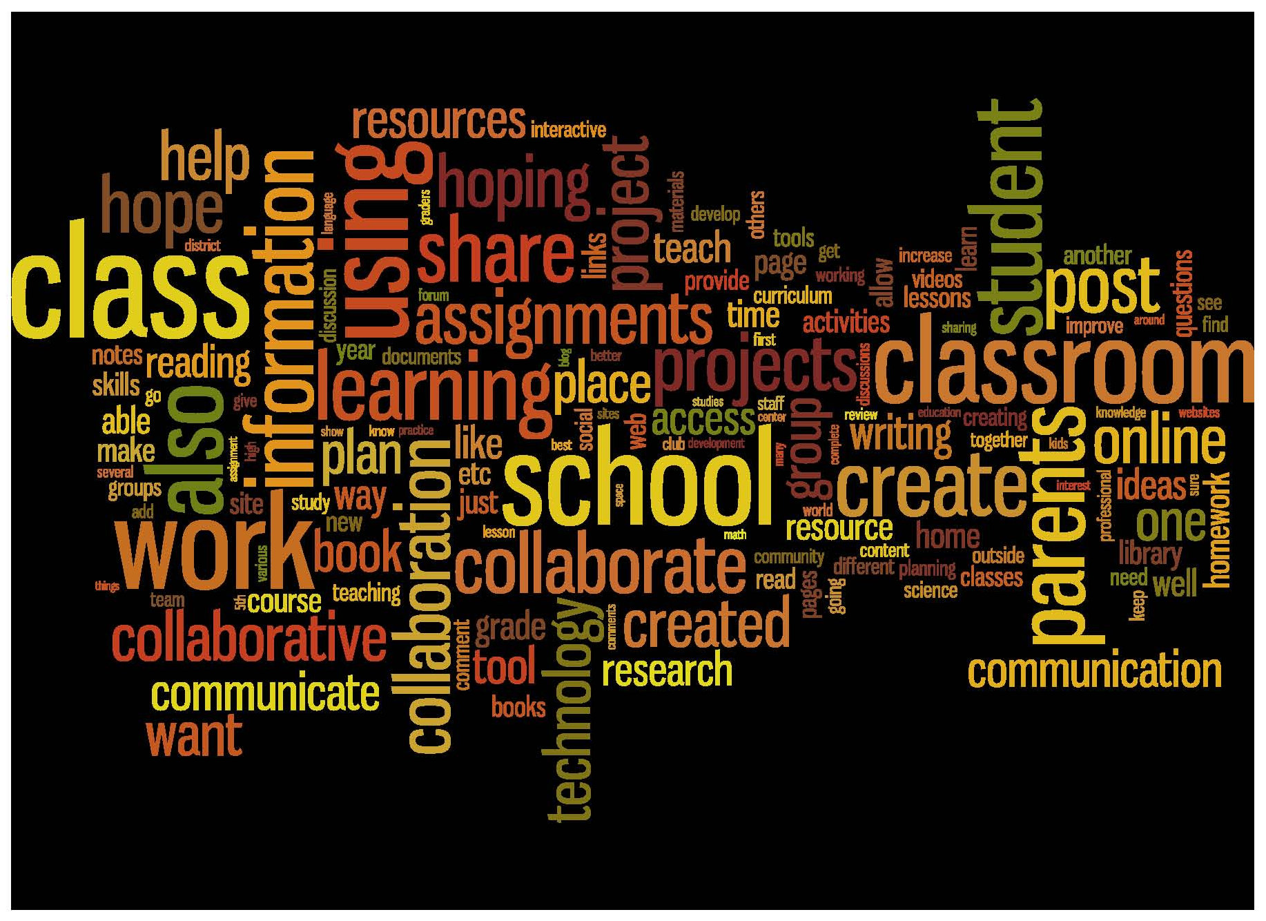
How do you plan to use your wiki? (n=667)
Omitted words: use, wiki, student

Slide 12
Why do teachers use wiki?
Develop technology skills
Develop communication and collaboration skills
Developing/demonstrating understanding
Information delivery and course logistics

Slide 13
Wiki quality as opportunities for
21st Century Skill Development
Expert Thinking
Complex Communi-cation
New Media Literacy

Slide 14
How do teachers assess wiki quality?
68 Interview subjects (nationwide)
19 Classroom Observations (MA, CA, VA, GA, NH, CT)
14 Randomly-sampled teachers
36 Randomly sampled
32 Purposively sampled
Broad cross-section of users
22 Randomly-sampled teachers
14 Purposively-sampled effective wiki users
411 U.S. K-12 wikis
~25,000 recently edited publicly-viewable, education related wikis as of September 2009
7 Purposively-sampled urban wiki users
1,799 wikis (1% random sample)
11 Purposively-sampled participants in an online wiki summer camp
178,851 publicly-viewable, education related wikis hosted on Pbworks.com 2005-8

Slide 15
How do teachers assess wiki quality?
Participation
Structure
Uncommon
Communicating Understanding
Collaboration
Common
Content
Notes:
. In most instances in our data, these common assessment criteria adhere poorly to the domains of 21st century skills while the uncommon criteria had greater alignment.

Slide 16
Common assessment categories
Content
Factual information
“Did the student discuss the economic platform of the country? Did the student include religious data about that area? ”

Slide 17
Common assessment categories
Participation
Required number of contributions during a given time period
“We have a specific number of responses that we expected from student. So even students who weren’t necessarily the most verbose, had to do like five answers in a one week period.”

Slide 18
Common assessment categories
Structure
Organization and relation of elements of the wiki pages
Many teachers required that student included a requisite number of design elements, such as a certain number of pages, paragraphs, or images. Some teachers also made a holistic evaluation of the organization and readability of the site.

Slide 19
Uncommon assessment categories
Collaboration
The ways in which students work together effectively on their wiki project
“I grade them on their comments to other people too. And I want their comments to other people to be thoughtful and I want them to provoke response.”

Slide 20
Uncommon assessment categories
Communication of understanding
Use new media design elements to communicate an understanding of academic material that requires building relationships among facts and ideas
“When I look at the wiki, I want to see images that in some way bring meaning to what the wiki is about. I want to see links to other websites that bring meaning to what the wiki is about. I like to see students reflecting upon their content in thoughtful ways either in comments or around their own pages.”

Slide 21
Overarching Theme
Following Directions
In most classrooms in our study, students are evaluated on their ability to complete structured tasks.
“Just that they'd followed the directions. It was kind of like, it wasn't high level thinking. But just that they follow the directions and included the information that I'd asked them to include.”

Slide 22
Wiki quality as opportunities for
21st Century Skill Development
Wiki assessment as demonstrating compliance
Expert Thinking
Complex Communi-cation
Participation
Structure
21st C Skills
Communicating Understanding
Collaboration
Following Directions
Content
New Media Literacy

Slide 23
Path Diagram of Wiki Research
School Level SES
Classroom Observations and Teacher Interviews to Understand Wiki Practices
Measure Wiki Quality
Develop Wiki Quality Trajectories
Assess How Wiki Quality Trajectories Differ by SES and Teacher Attitudes/Practices
Literature Review of CSCL and 21st C. Skill Scholarship
Initial Quantitative Analysis to Develop Sampling Strategy
Wiki User Surveys

Slide 24
Wiki Quality as Opportunities for Students to Develop 21st Century Skills
Participation
  Do students use wikis to get information? links? do they contribute?
Expert thinking:
  Do students use academic content knowledge in wiki activities?
  Do students reflect on the process/product?
Complex Communication/Collaboration:
  Do students concatenate text on pages?
  Do they substantively edit each others work and co-create pages?
New Media Literacy:
  Do students use formatting?
  Do they hyperlink?
  Do they embed multimedia?
Wiki Quality Instrument
25 Questions
Scale of 1-25

Slide 25
The State of Wiki Usage in U.S. K-12 Schools
What is the distribution of wiki quality?
  Do wikis provide opportunities for expert thinking, complex communication, and new media literacy?
  Are great wikis born or made?
Do wikis created in affluent schools provide more opportunities for 21c skill development than wikis created in low-income schools?

Slide 26
Which wikis are in our sample?
Dataset
  All179,851 publicly-viewable education-related wikis started on the PBworks platform between June 2005 and August of 2008.
  Does not include “private” wikis (~70,000)
Sample
  Randomly sampled 1,799 wikis (1%)
  Coded to identify 411 U.S. based, K-12 wikis
  259 from specific, identifiable public schools
    Detailed usage statistics provided by PBworks.com
    Demographic school level data from the Common Core of Data (National Center for Education Statistics, 2007-2008)

Slide 27
How did we measure wiki quality?
Sample wiki quality at 7, 14, 30, 60, 100, and 400 days
Two raters independently apply wiki quality instrument
  All raters must code “training set” of wikis within 1.5 points of master coders
  Weekly meetings while coding to discuss categories, difficult cases, etc.
Third rater reconciles disagreements

Slide 28
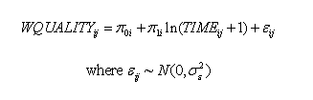
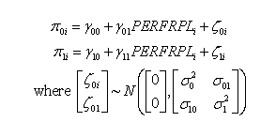
Data Analytic Strategy:
Multilevel Model for Change

Slide 29
Demographics

Slide 30
What subjects are wikis used for? (n=411)

Slide 31
What Grade Levels are K-12 wikis used in? (n=411)

Slide 32
How long do K-12 wikis persist? (n=411)
Estimated Lifetimes | Seconds | Days
All PBworks
25% | 250 | <1
50% | 123,613 | 1.4
75% | 5,282,874 | 61.1
K-12 Wikis
25% | 2,721 | <1
50% | 763,195 | 8.8
75% | 12,590,074 | 145.7
(231) (463) (694) (926) (1157)
Time in seconds (days)

Slide 33
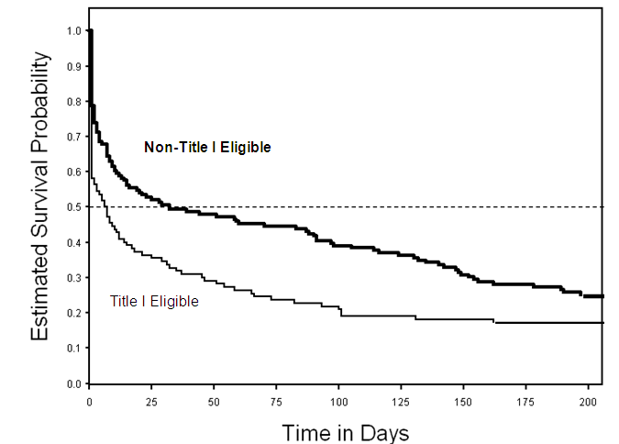
Estimated survivor functions for wikis hosted by Title I eligible (n=110) and non-Title I eligible schools (n=146).

Slide 34
What is the distribution of wiki quality?
Are great wikis born or made?

Slide 35
Prototypical wiki quality trajectory, controlling for % FRPL and subject area (n=259)

Slide 36
Prototypical Quality Trajectories for Domain Scale Scores (0-1) of Participation, Expert Thinking, Complex Communication, and New Media Literacy, controlling for SES (n=259).

Slide 37
Prototypical wiki quality trajectories created in High-SES (10% FRPL) and Low-SES (90% FRPL) schools, controlling subject area (n=259)

Slide 38
Prototypical wiki quality trajectories in subject areas, controlling for SES (n=259)

Slide 39
Takeaways
Teachers want to use wikis to develop 21st century skills
  BUT most teachers assess procedural compliance in wikis
Wikis are widely adopted in K-12 setttings
  BUT most wikis are teacher-centered, content-delivery devices
  AND are more persistently and efficaciously used in wealthier schools
Great wikis are born; initial norms matter

Slide 40

# of Cases
Time/Scale Web 2.0 Research State Space
1,000K
Modeling Usage Statistics
Simulations
100K
Semantic Analysis
10K
Surveys
1,000
Content Analysis
Interviews
100
10
Discursive Analysis
Biometric Analysis
Design Research
Observational Research
1
Seconds
Days
Weeks
Months
Years
Duration of data collection and capture

Slide 41
Questions for discussion
How can we support teachers in assessing 21st century skill development in online learning environment?
What kinds of targeted interventions would support teachers in using wikis to develop 21st century skills?
What kinds of actionable advice can we give teachers about wikis design, knowing that high quality wikis start at high levels of quality?
What kinds of targeted interventions in schools serving low-income students would close the “second digital divide” of usage?
How can a national perspective on wiki usage help situate and contextualize local studies?
How can we leverage other forms of SCRIBL data to characterize Web 2.0 usage at scale?

Slide 42
Back Deck

Slide 43
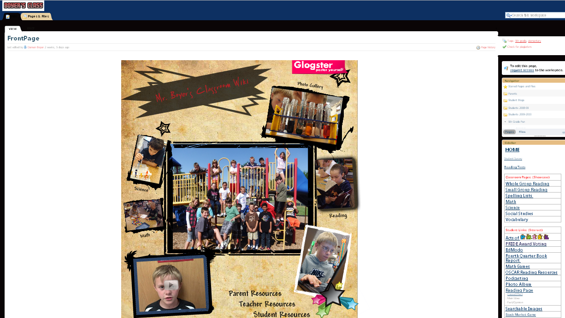

Slide 44
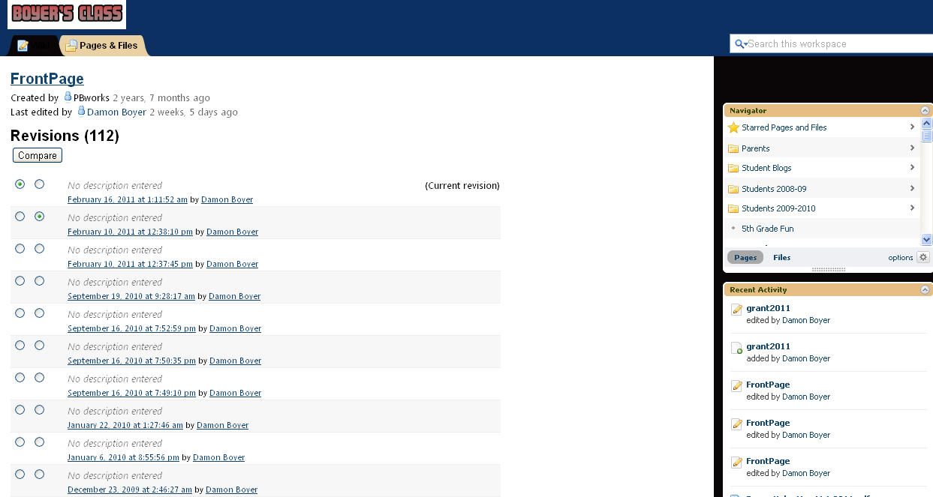

Slide 45
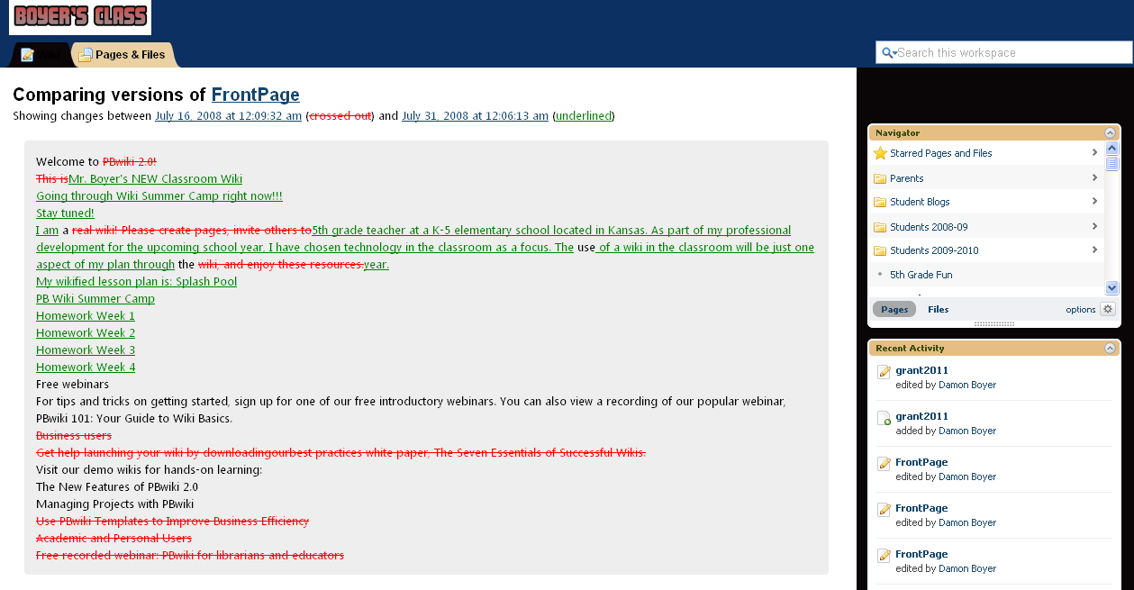

Slide 47
Moving average of wiki development measured in page saves

